Slide 1
ONLINE BOOK SHARING PLATFORM
Guided by Dr. Abu Sayed Md. Latiful Hoque
Presented By Latif Siddiq and Nadia Anjum

Slide 2
Branch Elements
Branch
Branch Id
Employee
Employee id
Book storage
Storage id
Transports
Transport id
Materials
Materials id
User
User id
Publisher
Publisher id
Location
Location id

Slide 3
Branch
Location
Location Id
Primary Key
Street Name
Postal Code
City
Book Storage
Storage Id
Primary Key
Employee id
Foreign key
Location Id
Foreign Key
Capacity
Branch Id
Foreign Key
Transport
Transport Id
Primary Key
Employee id
Foreign key
Location Id
Foreign Key
License number
Capacity
Branch Id
Material
Material Id
Primary Key
Material Name
Type
Branch Id
Foreign Key
Total

Slide 4
Employee
Employee
Employee id
Primary Key
Name
Location Id
Foreign key
Phone number
Department Id
Foreign Key
Branch Id
Foreign Key
Email Address
Hire date
Job Id
Foreign Key
Job
Job id
Primary Key
Job Name
Department Id
Foreign key
salary
Job History
Job Id
Foreign Key
Employee id
Foreign Key
Start Date
End date
Department Id
Foreign key
Branch Id
Foreign Key
Department
Department id
Primary Key
Department name

Slide 5
User and Publisher
Book
Book Id
Primary Key
Book Name
Type
Price
Publisher
Transaction Id
Foreign Key
Review id
Primary Key
Date
Book Id
Foreign key
Document
Review
User
User id
Primary Key
Name
Location Id
Foreign key
Phone number
Branch Id
Foreign Key
Id
Primary Key
Date
Transaction
User/publisher id
Foreign Key
Book Id
Foreign Key
Location id
Foreign key
Id
Primary Key
Publisher
Name

Slide 6
ER Diagram
gives
Job
Job id
Has
Materials
Materials Id
User
User Id
Buy/sale
Transaction
Transaction Id
has
Review
Review Id
Has
Having
Job history
Job id , Employee id
Through
gets
Sale
Has
Employee
Employee Id
Book
Book Id
Has
Branch
Branch Id
Has
Publisher
Publisher Id
In
Manages
Having
Has
Book storage
Storage Id
in
Transport
Transport Id
Department
Department id
Location
Location Id
In
Situated
Lives
Lives

Slide 7
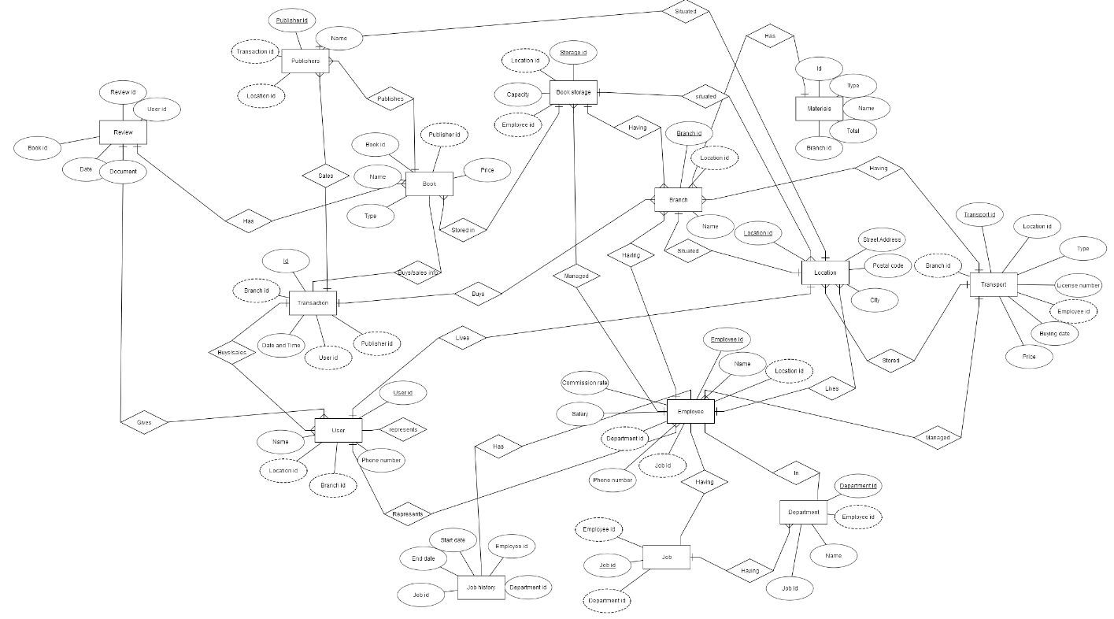
ER Diagram

Slide 8
THANK YOU
Feel free to ask questions.

